Slide 1
Boundary Extraction
Apoorva Jain
800904863

Slide 2
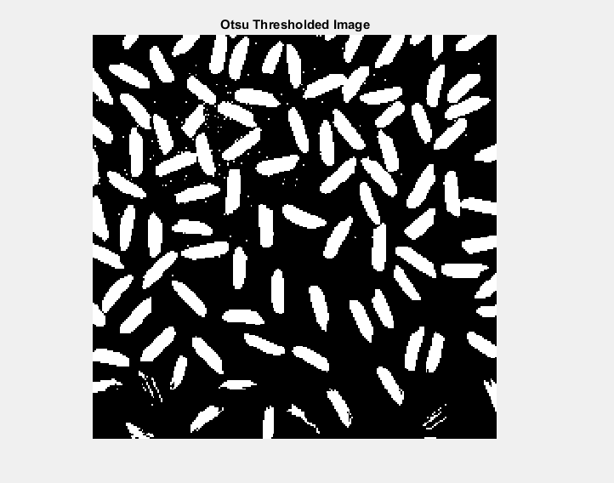

Slide 3
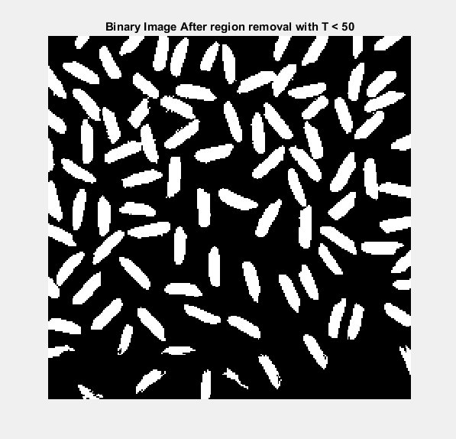

Slide 4
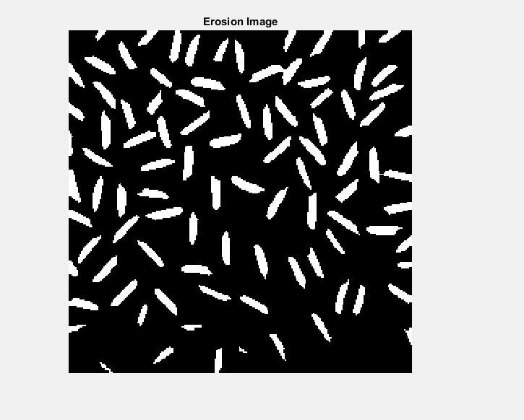

Slide 5
